Slide 1
Bioinformatics
Ranjan Jyoti Sarma
M.Sc, M.Phil.

Slide 2
Nucleotide Databases:
Repository of all nucleic acid sequences of major important Organisms.
Major Public Nucleotide databases: GeneBank, DDBJ and ENA (EMBL-EBI).
Exchange of data through International Nucleotide Sequence Database Collaboration (INSDC).

Slide 3
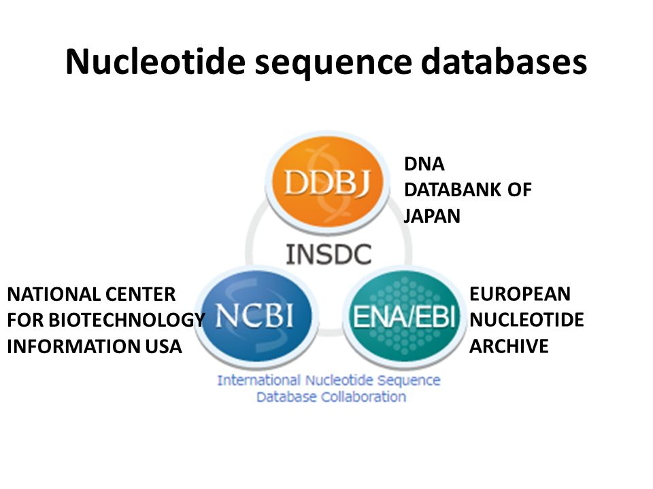

Slide 4
Other specialised Databases:
EST
Expressed Sequence Tags are the cDNA sequence (Highly expressed mRNA of portion of Gene) and less than 1000 bp: Used for gene discovery, construction of gene models, alternative splicing prediction, genome annotation, expression profiling, and comparative genomics.
In the helminth field, ESTs have extensive application in the discovery of new genes and identification of novel vaccine candidates and drug targets.
dbSNP:
dbSNP contains human single nucleotide variations, microsatellites, and small-scale insertions and deletions along with publication, population frequency, molecular consequence. Also genomic and RefSeq (Reference Sequence) mapping information for both common variations and clinical mutations.
A dense catalog of SNPs is expected to facilitate large-scale studies in association genetics, functional and pharmaco-genomics, population genetics and evolutionary biology, and positional cloning and physical mapping.

Slide 5
Protein Databases
Database of the protein sequences, and the 3D structural data produced by X-ray crystallography and macromolecular NMR.
PDB: A protein structure database contain structures of Proteins solved using X-ray crystallography, NMR and electron Microscopy.
SWISS-PROT: A well curated proteins sequence database also provides a high level of annotation.
Protein Information Resource (PIR) – Protein Sequence Database (PIR-PSD): The sequence in PIR-PSD is also classified based on homology domain and sequence motifs.
TrEMBL: Computer-annotated protein sequence database that is released as a supplement to SWISS-PROT. It contains the translation of all coding sequences present in the EMBL Nucleotide database, which have not been fully annotated.
Pfam: Pfam is a database of protein families that includes their annotations and multiple sequence alignments generated using hidden Markov models.

Slide 6
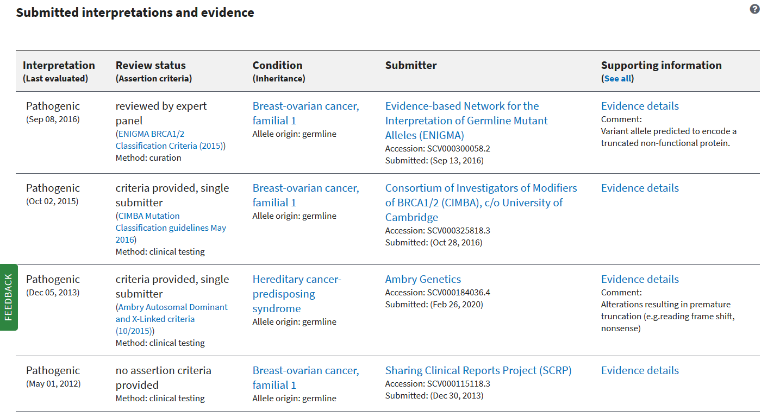
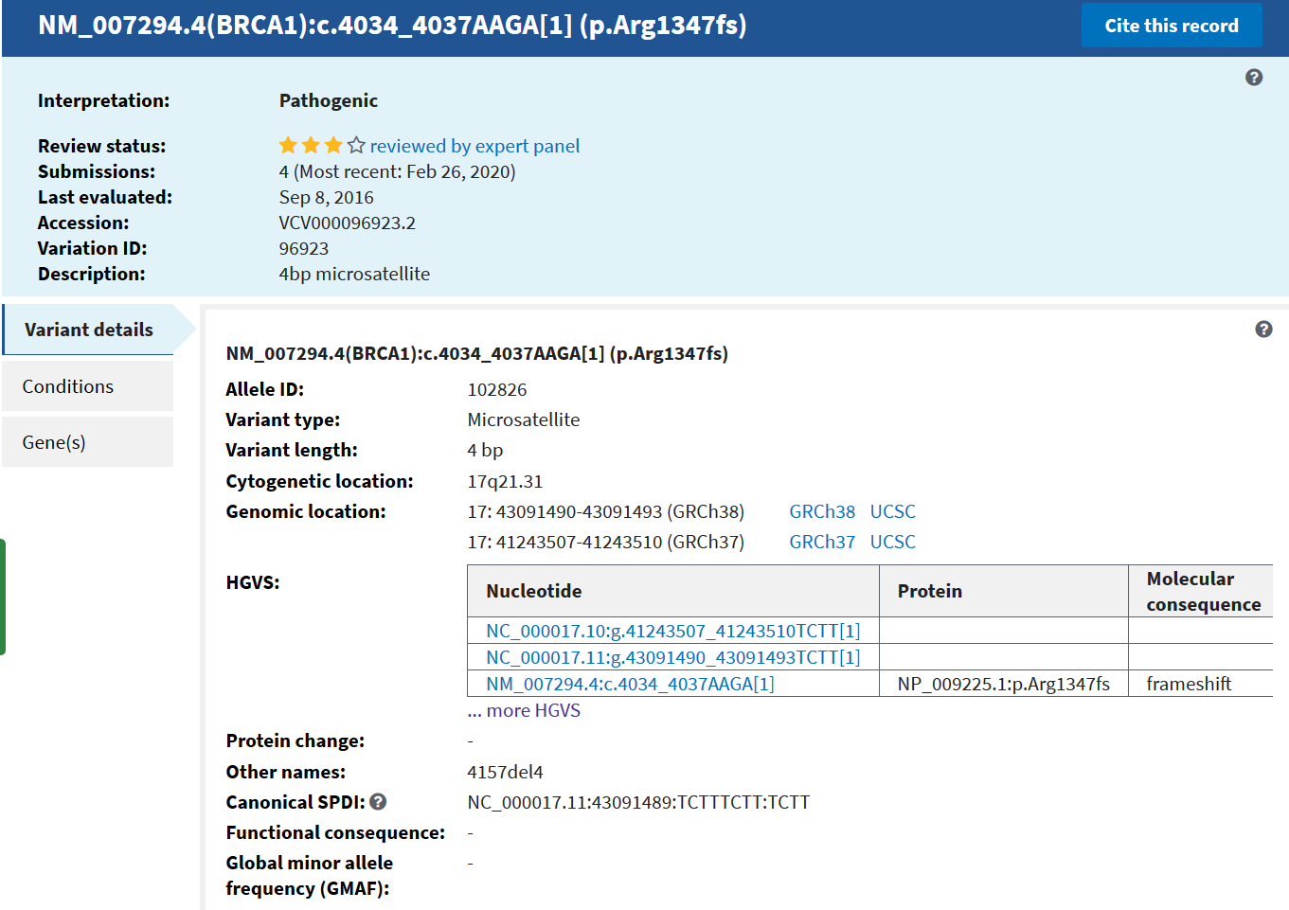
ClinVar
Stores variants with Clinical interpretation.

Slide 7
Defining Sequence Analysis:
Sequence Analysis is the process of subjecting a DNA, RNA or peptide sequence to any of a wide range of analytical methods to understand its features and functions.
It includes:
Sequencing and Sequence assembly.
Alignment and Database Searching.

Slide 8
Genome Browsers:
What do you mean by complete genome? Answer will be complete DNA sequences.
If so, then How to view it interactively?
Genome browser enables it to explore the complete genome or the region of the genome of your interest.
Genome browser provides a graphical interface for users to browse, search, retrieve and analyze genomic sequence and annotation data.
Some Genome Browsers: Web Based NCBI Genome Viewer, Ensemble, UCSC and Standalone IGV (Integrative Genome Browser), IGB (Integrated Genome Browser) and ArrayGene Genome Browser (Commercial Genome Browser developed by ArrayGen Technologies Pvt. Ltd. , Pune, India)

Slide 9
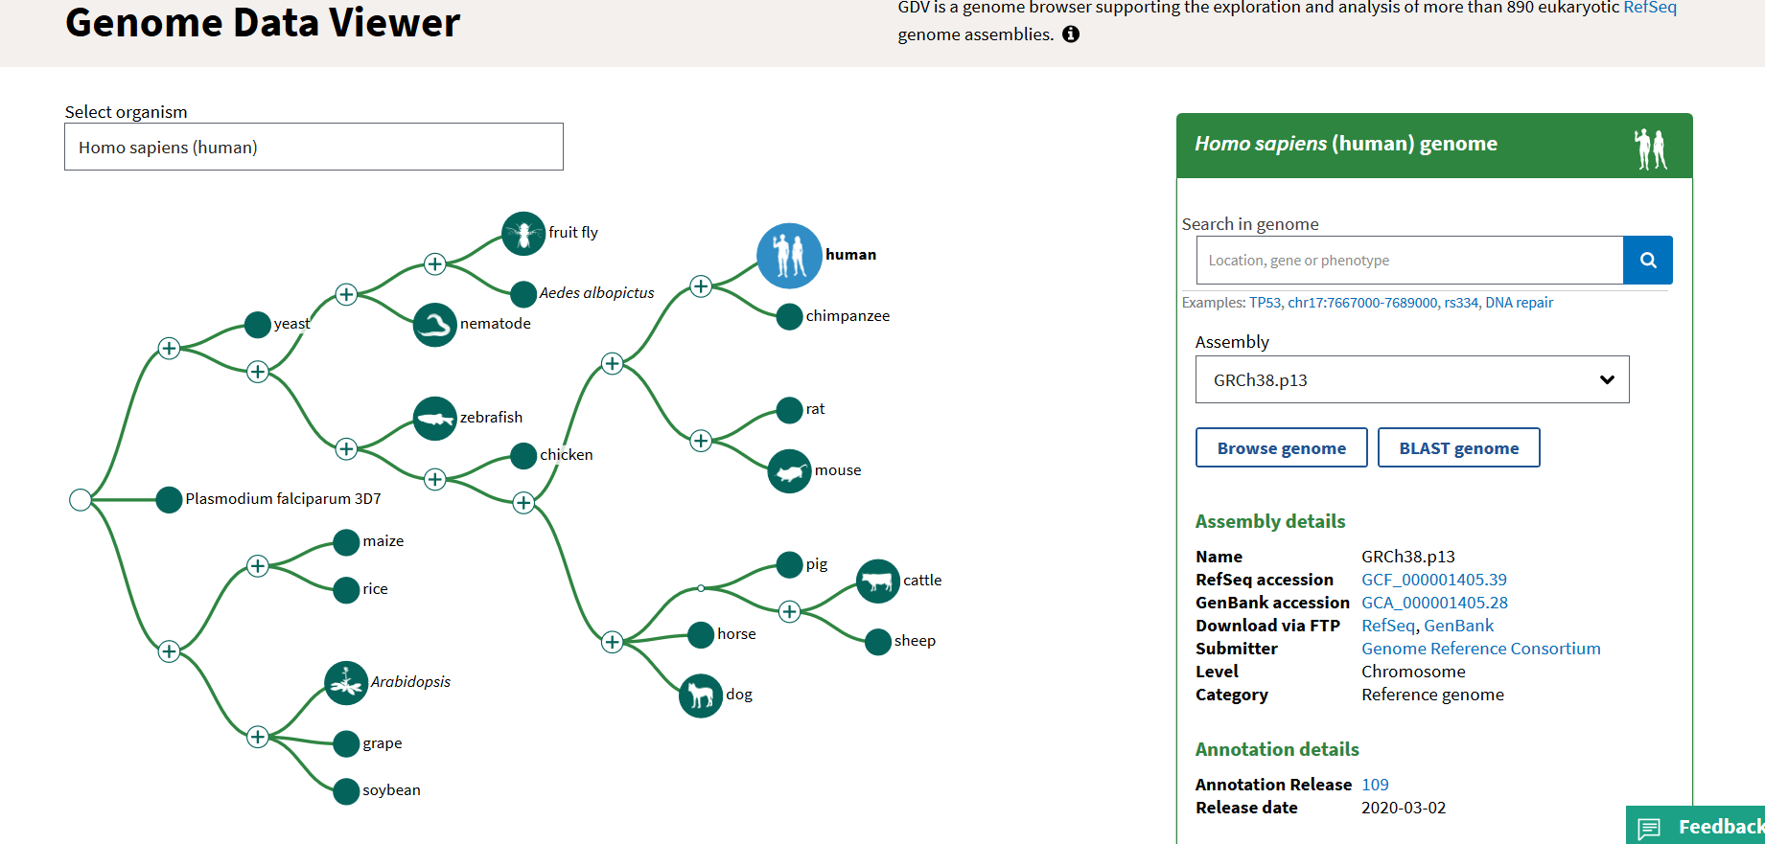
Gene name or Chromosome Location
Current Genome Assembly
Organism List

Slide 10
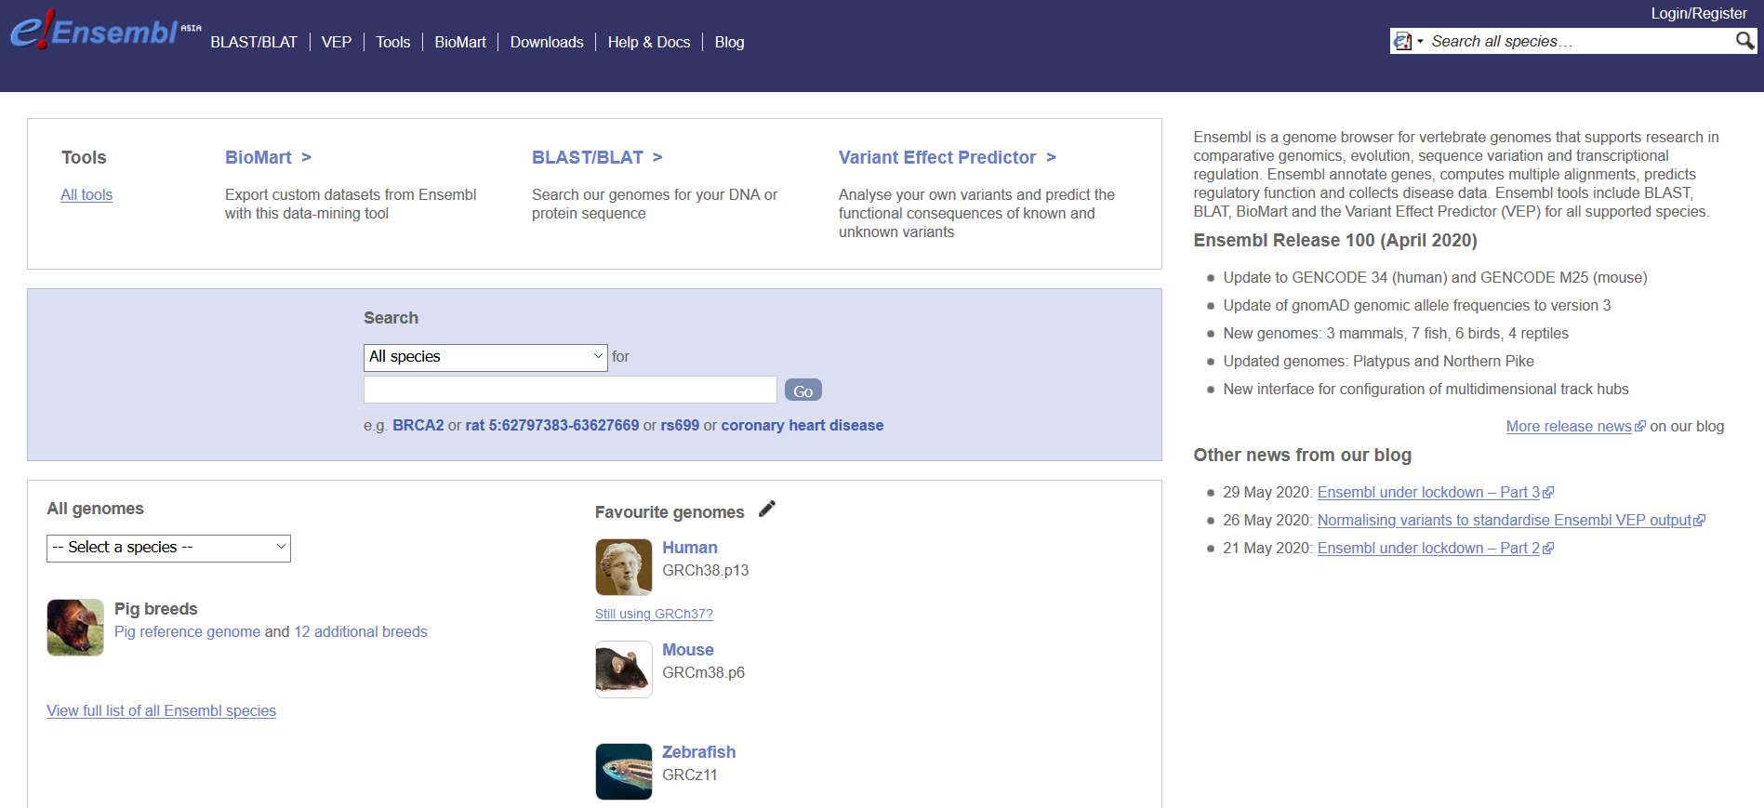
Ensemble Genome Browser for Vertebrates:

Slide 11
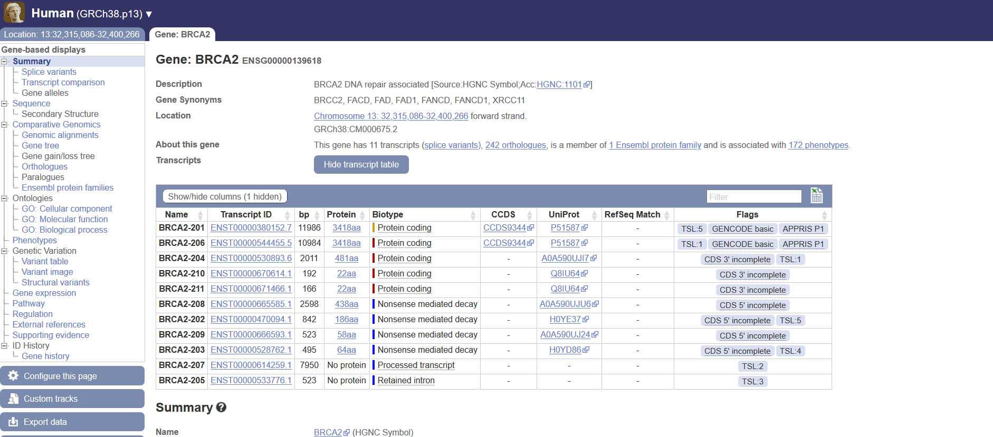
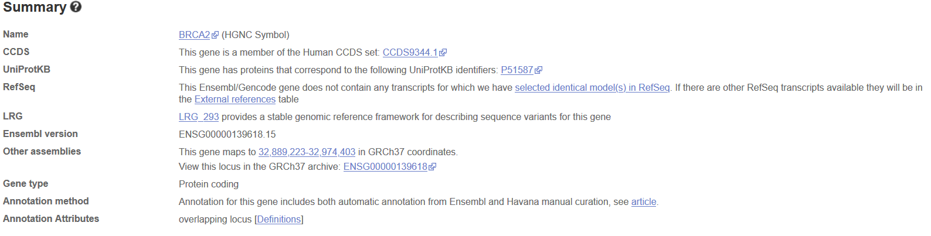

Slide 12
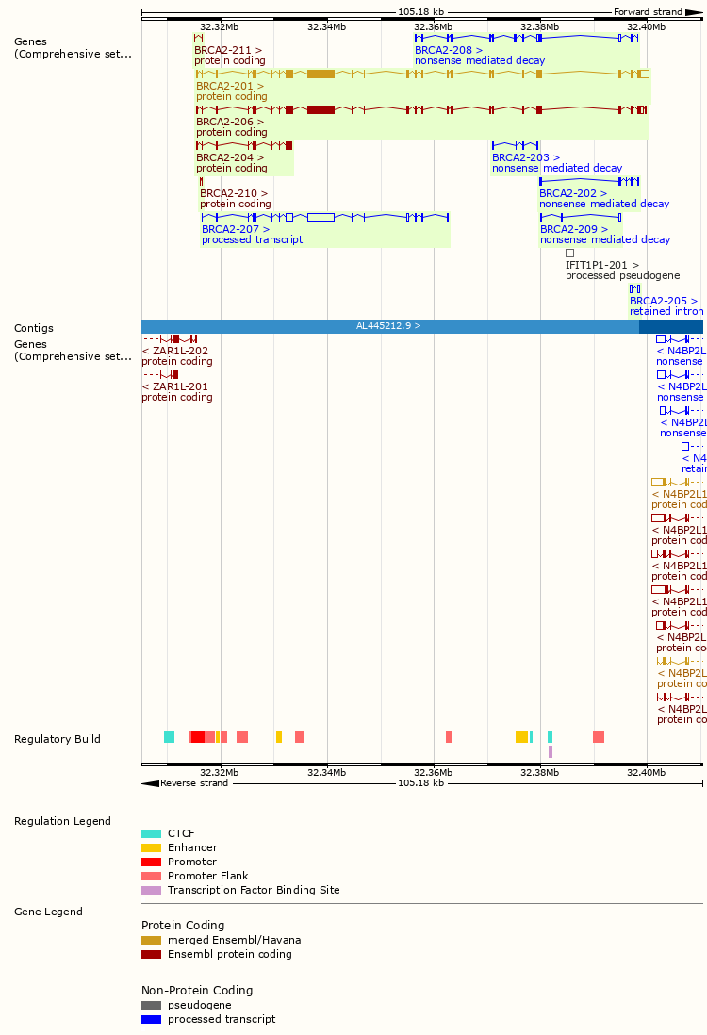

Slide 13
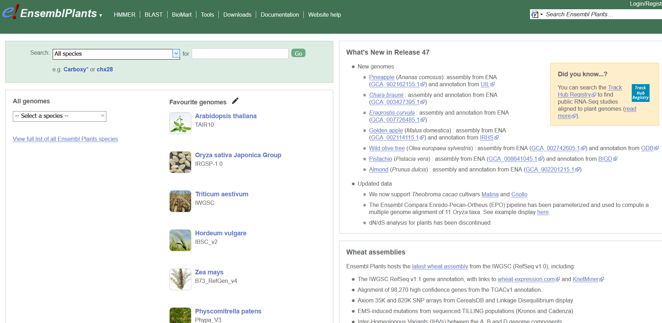
Ensemble Genome Browser for Plants:

Slide 14
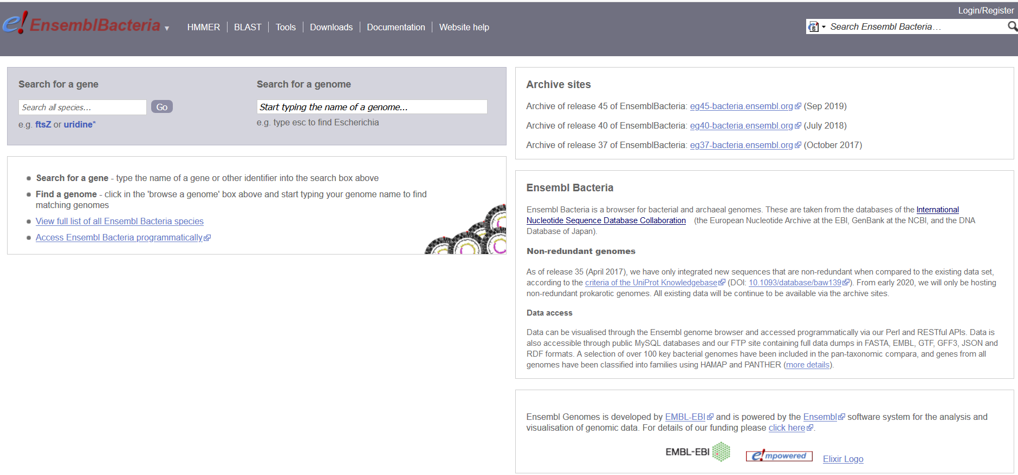
Ensemble Genome Browser for Prokaryotes:

Slide 15
DNA sequencing is the process of determining the precise order of nucleotides or order of the four A,T,G and C in DNA Strand.
Methods:
Sanger Sequencing or Chain Termination Method.
Next Generation Sequencing.

Slide 16
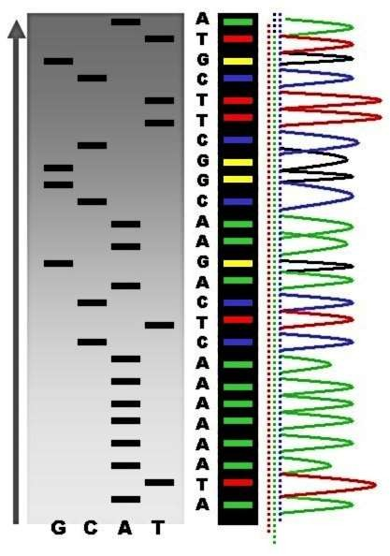
Fluorescence-Based Sequencing
I
N
D
I
V
I
D
U
A
L
SEP
ER
ATE
D
NU
CLE
OTI
DE
SE
QU
EN
CES
P
E
A
K
S

Slide 17
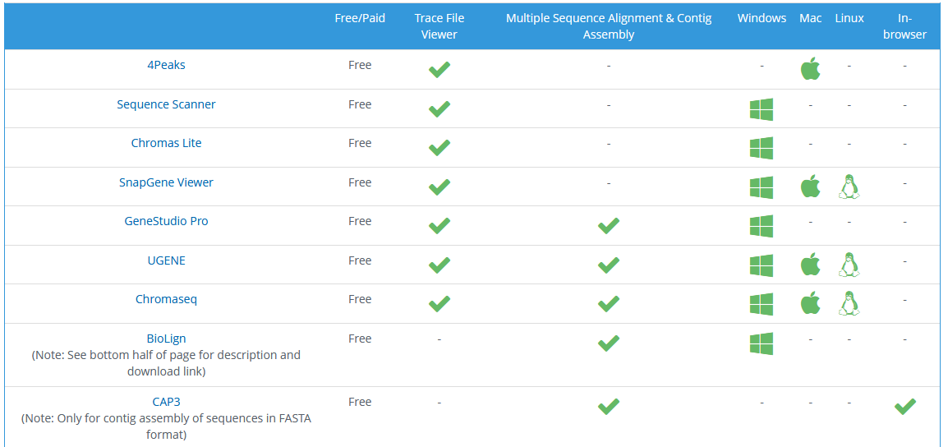
Tools for Viewing Sanger Sequencing Data:

Slide 18
Quality Value: -10 log10 Pe
QV10: 10% or 1/10 Chance that the base call is incorrect.
QV20: 1% or 1/100 Chance that the base call is incorrect
QV30: 0.1% or 1/1000 Chance that the base call is incorrect
QV40: 0.01% or 1/10000 Chance that the base call is incorrect
QV50: 0.001% or 1/100000 Chance that the base call is incorrect.

Slide 19
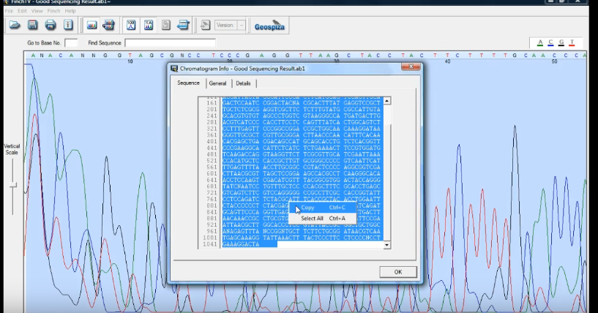
SIMILARITY SEARCH
Finch TV

Slide 20
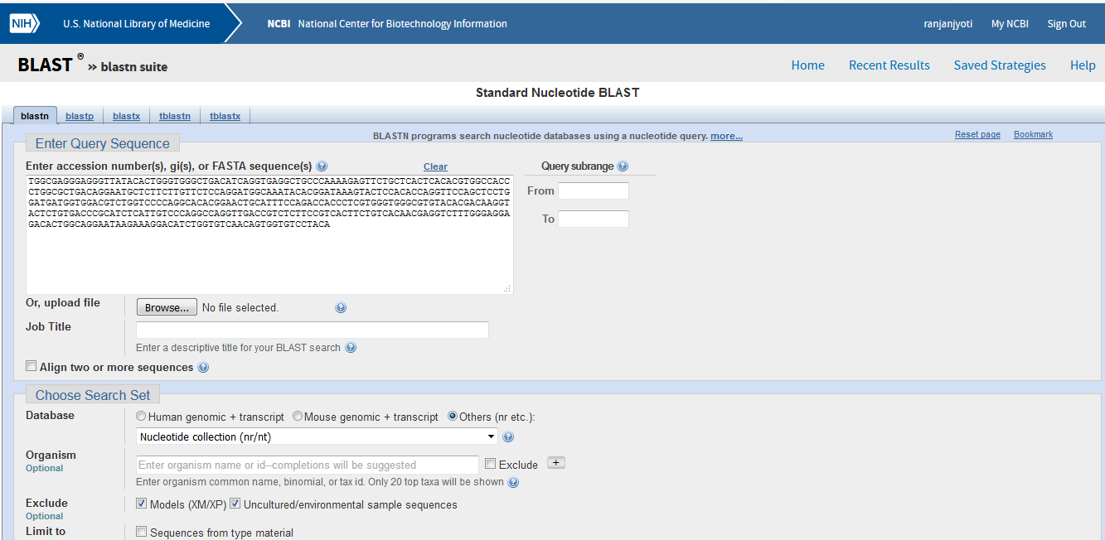
BLAST

Slide 21
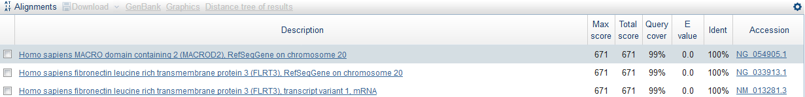
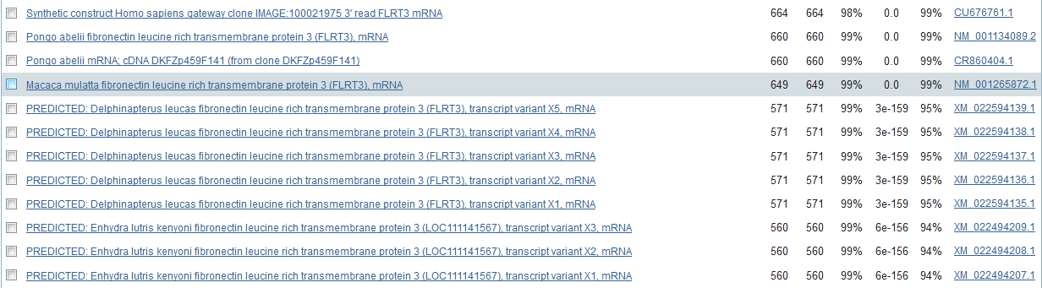
BLAST RESULT

Slide 22
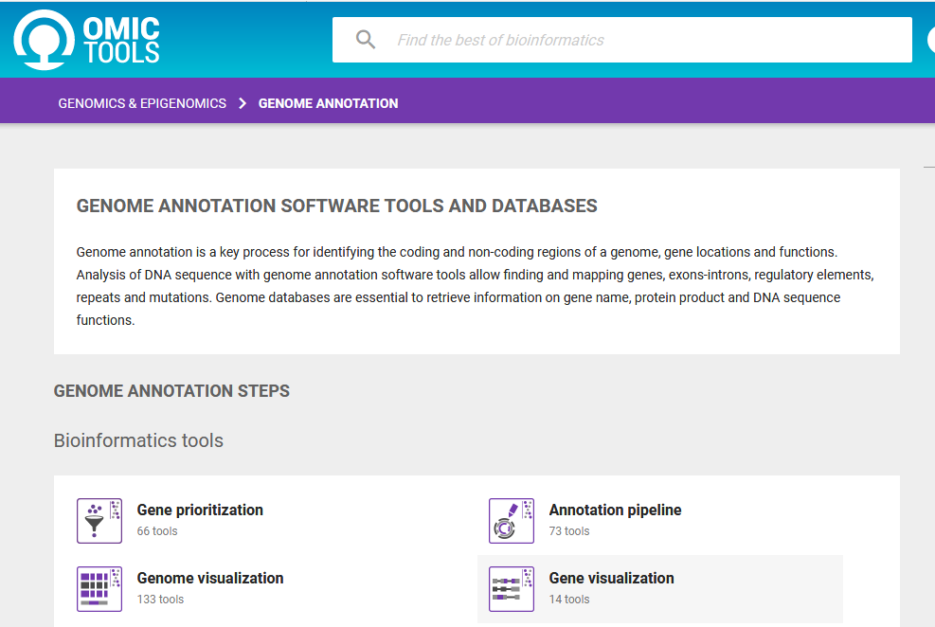
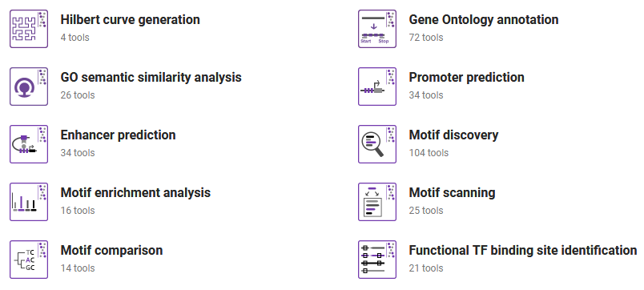
ANNOTATION
What do you mean by feature annotation and why do we need to annotate the sequences?
Genome annotation is the process of finding and designating locations of individual genes and other features on raw DNA sequences, called assemblies.

Slide 23
Feature annotation is the addition of biological features such as genes and associated coding regions, structural RNA, variation information, exon, introns, etc. to your submitted sequence.
The annotation should include the location of the feature (start and stop) and a description of the feature.
The addition of feature annotation to the sequence:
Improves the quality of your submission.
Increases the efficiency with which your submitted sequences are processed by members of the GenBank staff.
Is of far greater use to the scientific community than sequence data alone.

Slide 24
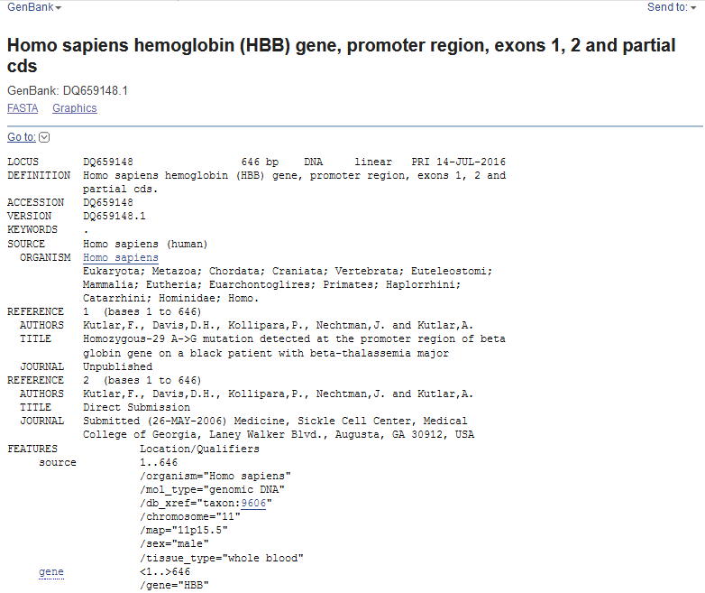

Slide 25
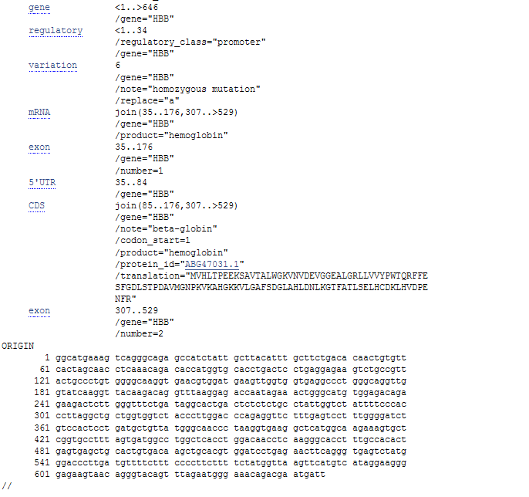

Slide 26
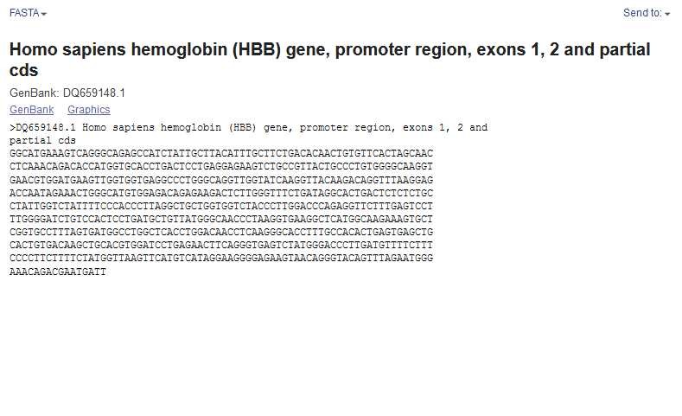

Slide 27
Sequence Alignment
The sequence alignment is made between known sequence and unknown sequence or between two unknown sequences.
The known sequence is called reference sequence. The unknown sequence is called query sequence.
Sequence alignment is useful for discovering structural, functional and evolutionary information.
Different algorithms available for alignment are used depending on the requirement.

Slide 28
Types of Sequence Alignment
Global Alignment (Needleman-Wunsch Algorithm)
Local Alignment (Smith-Waterman Algorithm)
Global Alignment : is a matching the residues of two sequences across their entire length.
Global alignment matches the identical sequences .
Local Alignment : is a matching two sequence from regions which have more similarity with each other.
These methods are mostly defined by Dynamic programming approach for aligning two different sequences.

Slide 29
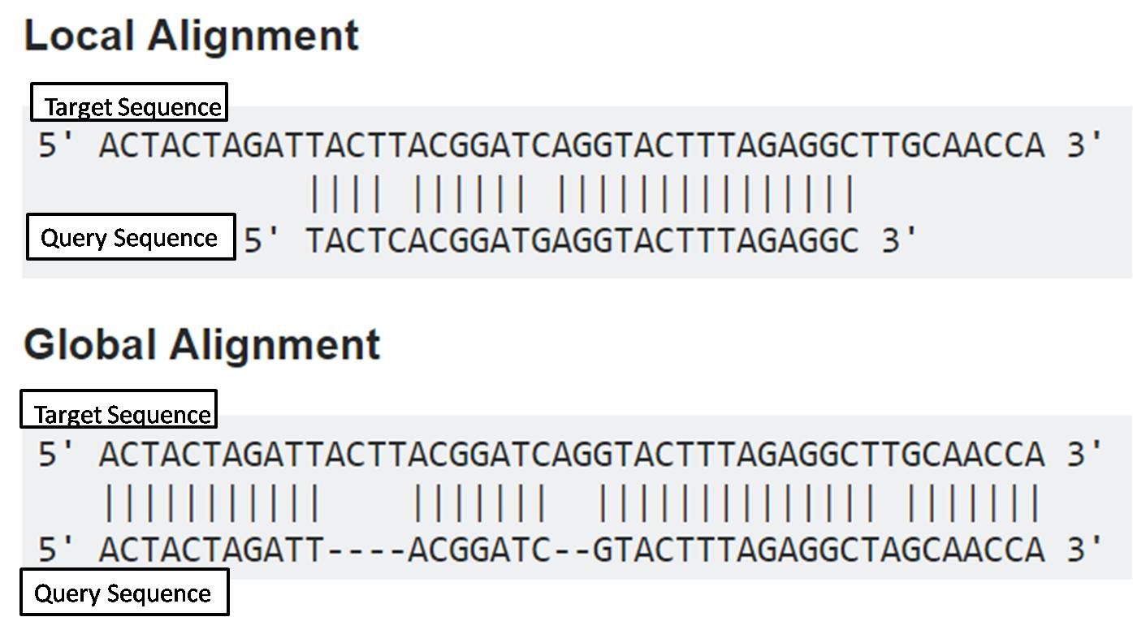

Slide 30
Pairwise Sequence Alignment is used to identify regions of similarity that may indicate functional, structural and/or evolutionary relationships between two biological sequences (protein or nucleic acid).
Multiple Sequence Alignment (MSA) is the alignment of three or more biological sequences of similar length. From the output of MSA applications, homology can be inferred and the evolutionary relationship between the sequences studied.

Slide 31
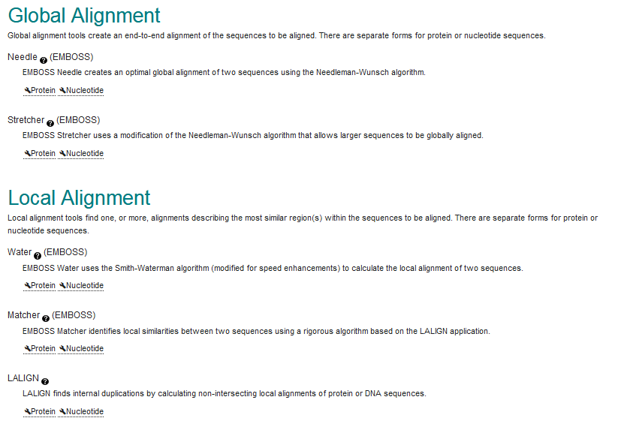

Slide 32
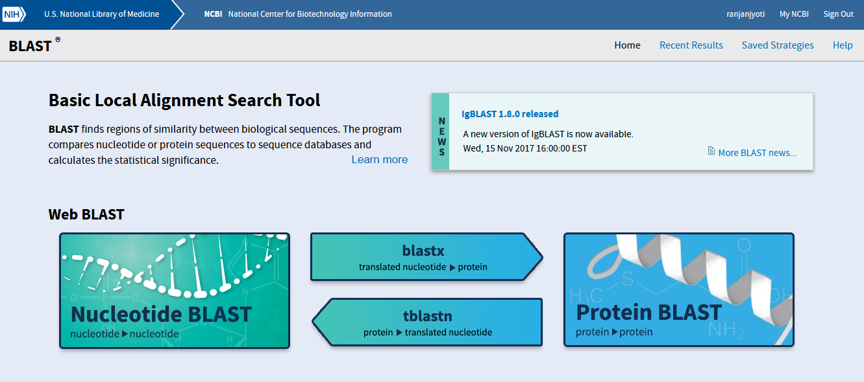
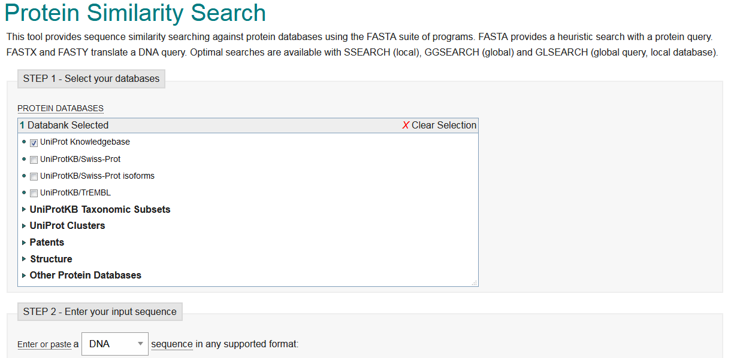
NCBI-BLAST
FASTA

Slide 33
DYNAMIC PROGRAMMING
It finds the alignment in a more quantitative way by giving particular scores for matches and mismatches.
The Dynamic Programming solves the original problem by dividing the problem into smaller independent sub problems.
Scoring matrices:
PAM Matrix
BLOSUM Matrix
Gap Penalty

Slide 34
PAM matrices are calculated by observing the differences in closely related proteins.
One PAM unit (PAM1) specifies one accepted point mutation per 100 amino acid residues, i.e. 1% change and 99% remains as such.
BLOcks SUbstitution Matrix, developed by Henikoff and Henikoff in 1992, used conserved regions.
These matrices are actual percentage identity values. Simply to say, they depend on similarity. BLOSUM 62 means there is 62 % similarity.
Gap Penalty - Dynamic programming algorithms use gap penalties to maximize the biological meaning.
Gap penalty is subtracted for each gap that has been introduced.

Slide 35
Identity: Identical Sequences.
E-Value: The E-value provides information about the likelihood that a given sequence match is purely by chance.
The lower the E-value, the less likely the database match is a result of random chance and therefore the match is more significant.
E < 1e - 50 (or 1 × 10⁻⁵⁰ ), there should be an extremely high confidence that the database match is a result of homologous relationships.

Slide 36
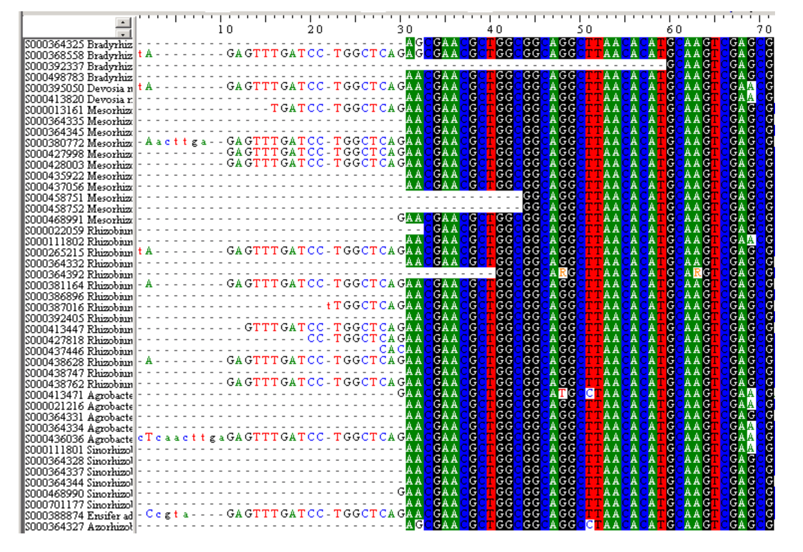
Multiple Sequence Alignment

Slide 37
Why we do multiple alignments?
In order to characterize protein families, identify shared regions of homology in a multiple sequence alignment; (this happens generally when a sequence search revealed homologies to several sequences)
Determination of the consensus sequence of several aligned sequences.
Help prediction of the secondary and tertiary structures of new sequences;
Preliminary step in molecular evolution analysis using
Phylogenetic methods for constructing phylogenetic trees.

Slide 38
Multiple Alignment Method
The steps are summarized as follows:
Compare all sequences pairwise.
Perform cluster analysis on the pairwise data to generate a hierarchy for alignment. This may be in the form of a binary tree or a simple ordering
Build the multiple alignment by first aligning the most similar pair of sequences, then the next most similar pair and so on. Once an alignment of two sequences has been made, then this is fixed. Thus for a set of sequences A, B, C, D having aligned A with C and B with D the alignment of A, B, C, D is obtained by comparing the alignments of A and C with that of B and D using averaged scores at each aligned position.

